Slide 1
WebAPI & OpenAPI (Swagger)
With some history and RESTful Principles

Slide 2
Aims
A quick explanation of Distributed Computing, RPC and WebAPIs
Explain what WebAPIs are with some insight into how they work
What is RESTful?
Explain what Swagger does and how it helps

Slide 3
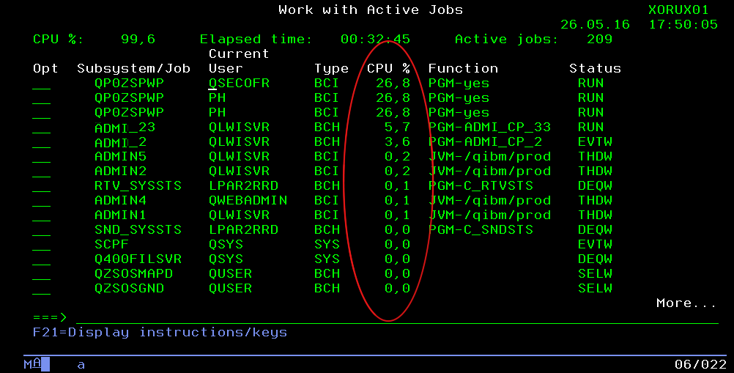
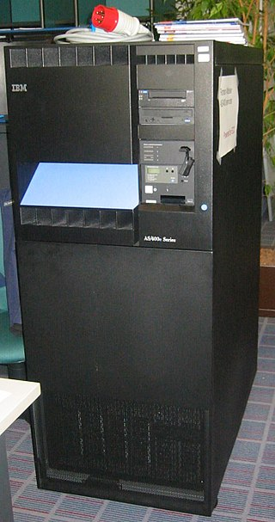
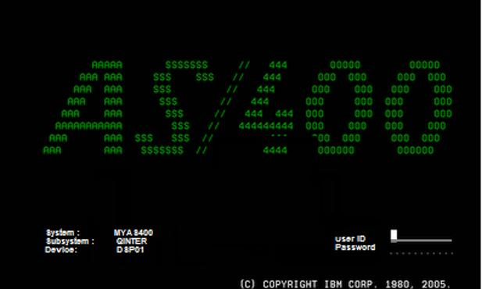
In Ancient Times…
VT100, VT220, Escape sequences, RS232, RS422, Ethernet.
Multiuser Time Sharing System
Processed on server – UI sent to terminals

Slide 4
Observations
✗ Limited user-count as users are programs running on the server
✓ Good performance because of fast access from program to data

Slide 5

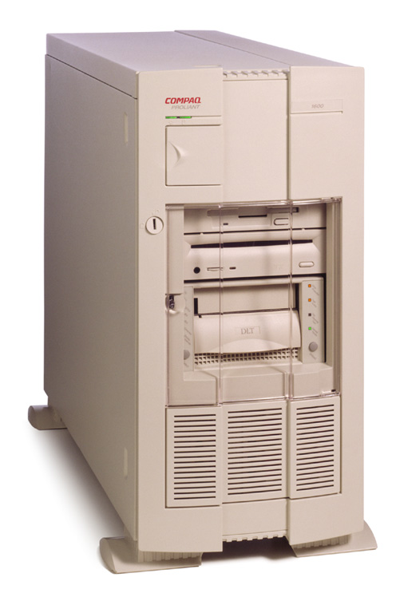
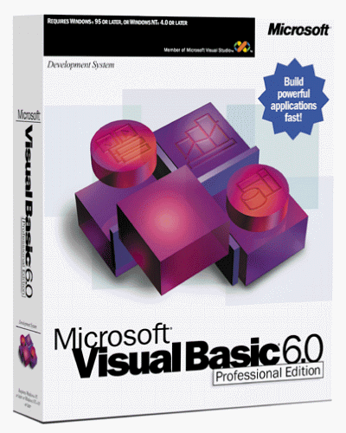
Then The Revolution – Client/Server…
DBMS with Open/Close
Connections
(Often left open to ‘improve’ performance)
Processing shared on client and server

Slide 6
Observations
✗ Limited users because of limited database connections
✗ Applications often retain connections to improve performance – further limiting more users
✗ Applications reside on client machines – updates are more complex
✓ Distributed performance because client computer retrieves data to process locally
✓ Client machines can provide a better user interface

Slide 7
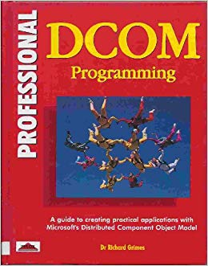

Some Progress – Distributed ‘Objects’
Application Server
Database Server
RPC
SOAP
Processing shared on application and database server

Slide 8
Observations
✗ Application servers are difficult to scale out requiring complex load sharing
✗ Applications still reside on client machines – updates are more complex
✓ Application server (business rules) software is updated in one place
✓ Well written application server software can manage and share connections
✓ Distributed performance because business rules can be processed on application server
✓ Client machines can provide a better user interface

Slide 9



Then The Second Revolution – Web Applications
Web Server
Web Server
Load Balancer
Database Server
Cache Server
Web Server
Web Server
Web Server

Slide 10
Observations
✗ Database can still be a ‘bottleneck’ especially when overburdened with business processing
✓ Web servers are relatively easy to scale out facilitating thousands of users
✓ Applications (business rule and UI) reside on web servers – easier to update
✓ Web applications are (largely) ‘stateless’ – connections are obtained for each web request
✓ Distributed performance because business rules can be processed on web server
✓ Client browsers can provide a rich and ‘responsive’ user interface

Slide 11
What is a WebAPI?
A Web API is an application programming interface for either a web server or a client application.
An application programming interface (API) is a set of subroutine definitions, communication protocols, and tools for building software. In general terms, it is a set of clearly defined methods of communication among various components. A good API makes it easier to develop a computer program by providing all the building blocks, which are then put together by the programmer

Slide 12
WebAPIs Leverage From Web Application Technology
WebAPIs can:
Use the same scalable architecture as Web Applications
Use the same encryption schemes as Web Applications
Use the same authentication and authorisation mechanisms as Web Applications
Serve web applications AND client applications such as mobile apps, desktop apps and external systems
Provide long running processes as well as request-response business rules

Slide 13
What is REST? (A full discussion would take longer than the time allocated)
REST stands for Representational State Transfer. It is an architectural style originally described by Roy Fielding, one of the authors of HTTP 1.0 and 1.1. It is a stateless architecture that uses the Web's existing protocols and technologies.
REST uses six constraints:
Uniform Interface
Stateless
Cacheable
Client-Server
Layered System
Code on Demand (optional)

Slide 14

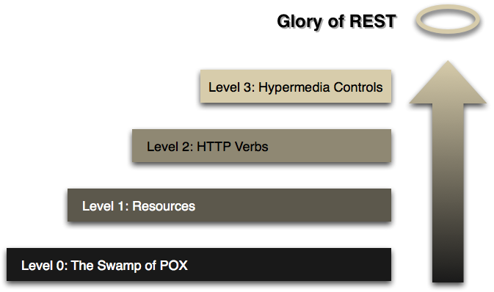
Richardson Maturity Model
Link
https://restfulapi.net/richardson-maturity-model/
Article by Martin Fowler
https://martinfowler.com/articles/richardsonMaturityModel.html

Slide 15
WebAPI Style – RPC vs. RESTful
RPC has a Verb-Noun style such as ‘GetCustomer’, ‘FindCustomer’, ‘LoadCustomer’, etc.
RPC has parameters passed in a query string e.g. GetCustomer?id=54321&return=nameandaddress
RESTful uses HTTP verbs (passed in request header) and passes many parameters in the Url
HTTP Verbs frequently used are:
GET [analogous to SQL SELECT] e.g. HTTP GET->/customer/54321
PUT [analogous to SQL UPDATE] e.g. HTTP PUT->/customer/54321 (with data in request body)
DELETE [analogous to SQL DELETE] e.g. HTTP DELETE->/customer/54321
POST [analogous to SQL INSERT] e.g. HTTP POST->/customer (with data in request body)

Slide 16
WebAPI Style – RPC vs. RESTful (cont.)
RESTful structures ‘resources’ in a uniform interface often with a hierarchical style
For example:
HTTP GET->/customer/54321/contact-history
HTTP GET->/customer/54321/permissions
HTTP GET->/customer/54321/orders
HTTP GET->/order/12345
HTTP GET->/product/9876

Slide 17
Why Does It Matter?
A couple of ‘easy’ reasons:
A good, well designed, structured API makes it easier to develop a computer program by providing all the building blocks, which are then put together by the programmer
The use of well designed Urls make it possible to cache responses meaning less load on the web and database severs
For example:
HTTP GET->/customer/54321 is going to respond with the same details all day long and so the response can be cached by a caching server. If the customer details are updated then either the cached record is immediately invalidated or a business rule is agreed that the cached details will be retained for, say 5 minutes.

Slide 18
What Is Swagger?
Swagger allows us to describe the structure of our APIs so that software can read them
The Swagger description can be used to provide ‘live’ up to date documentation from the code
The Swagger UI can be used to explore the API.
The Swagger description can be used to automatically generate client software that uses the API

Slide 19
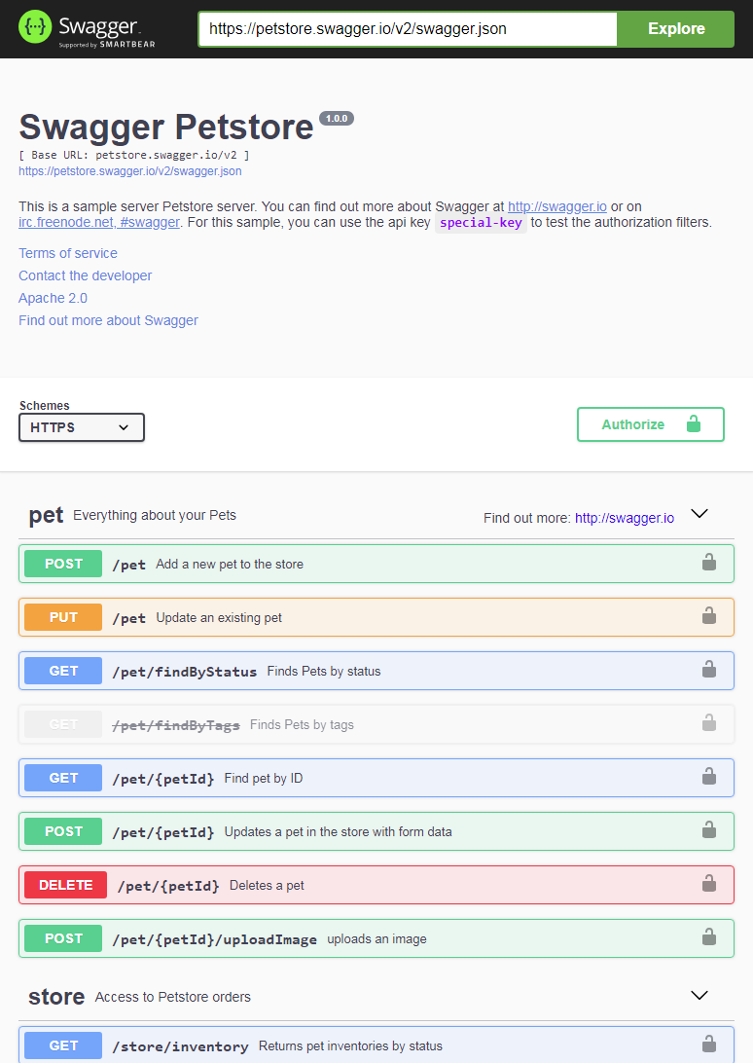
Swagger Documentation
https://petstore.swagger.io/

Slide 20
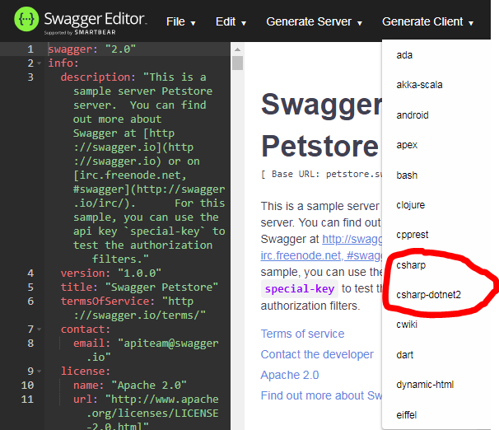
Swagger Code Generation

Slide 21
Demonstration, Any Questions & Useful Links
Link to example WebAPI -> https://github.com/carlclarke/SwaggerRESTDemo
Link to Swagger (it is now called OpenAPI) -> https://swagger.io/
Link to the OpenAPI Initiative -> https://www.openapis.org/
I am Carl Clarke, a software developer with more than 30 years of experience. I have developed everything from device drivers, applications for audio processing and high speed graphics processing to commercial transaction processing systems and rich user interfaces, using primarily assembler, C & C++ and more recently C#.
I have worked for Bank of England, Metropolitan Police, Defra, MoD, BP, RBI, Cubic Transport (Oyster Card), ACE Insurance, Thales, Unum, ICL, Fujitsu, BCP, SSP, Skybridge, Omron, Compliance, Atlas Capital, APT (the aptX people), Digigram, BBC and SABC as developer, PM, TPM, TA and TDA.
Long ago I was the Publicity Manager for five years with a large electronics and industrial automation company producing catalogues, PR, advertising and other marketing communications.
email: mail@carlclarke.com // phone: +44 7770 461212 // github: https://github.com/carlclarke/
linkedin: www.linkedin.com/in/carlclarke1 // cv: https://www.dropbox.com

